Slide 1
Components Within the Western Blot
FB 3131 Cells Treated with SiRNA
SiRNA = Small Interfering RNA
Effect of SiRNA = Reduces the translation of proteins
This mechanism is known as a ”knockdown”

Slide 2
YTHDC1 SiRNA
YTHDC1 is a protein that mediates m6a methylation for RNA sequences
M6a is a type of RNA modification
The 6 represents the position of the modification
It occurs at the nitrogen 6 position

Slide 3
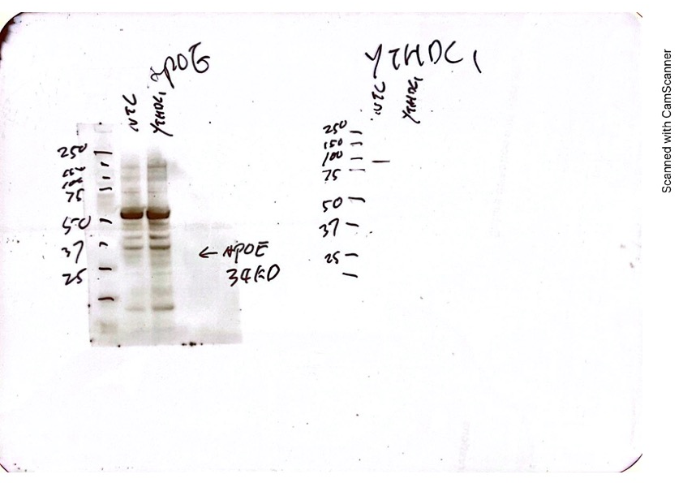
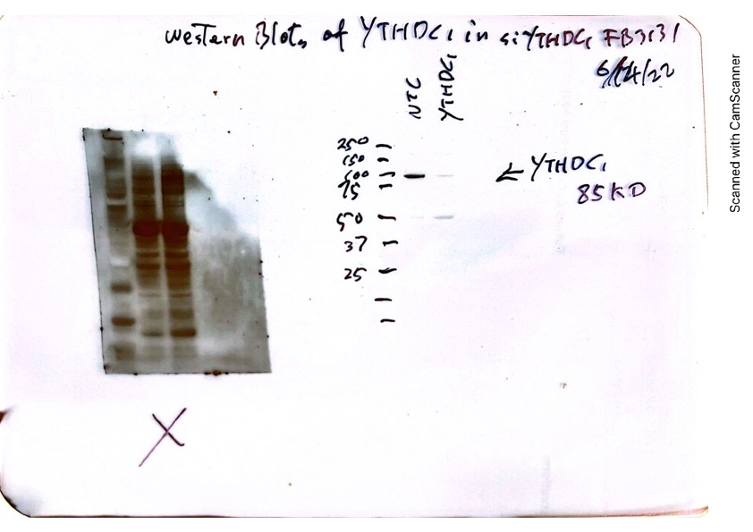
Western Blot Results
The First Attempt at Imaging
Second Attempt at Imaging

Slide 4
Complications
RT-PCR Results did not connect with the Western Blot Results
The CT mean did not increase for YTHDC1, negative control showed positive results
CT = number of cycles required for a fluorescent signal to exceed background levels
Inverse relationship between cycles and amount of target nucleic acid

Slide 5
Future Plans…
Transfecting the cells again
Run it through the RT-PCR
Run another Western Blot to check the effectivity of the SiRNA

